Slide 1
Live Forensic Acquisition Techniques
Joe Partlow, CISO
B-Sides Tampa 2015

Slide 2
Whoami
Joe Partlow (jpartlow@reliaquest.com)– CISO, ReliaQuest
Been in the IT and information Security industry for 15+ years and has experience in Operations Management, Information Security, Network Security, Systems Design, Risk Assessment, Database Administration, Network Infrastructure, Web Application Development, Systems Design & Integration and Project Management.
Just a guy interested in forensics!

Slide 3
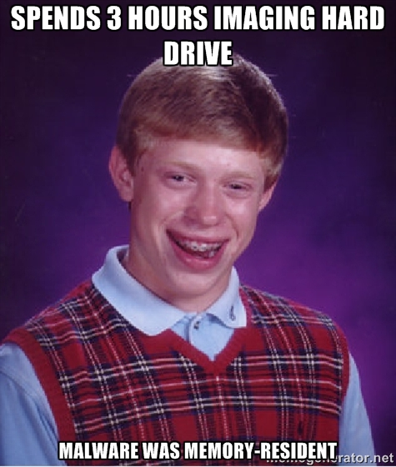
What is Live Acquisition?
Live acquisition is the process of pulling forensic artifacts from a running machine
But wait!!! Doesn’t that violate the rule about pulling the plug immediately?
DD or similar being the sole method of forensics been dead for years but surprised how often I still run into this mindset (from customers and from fellow forensic people)

Slide 4
Why is it important?
Many valuable artifacts may disappear when shutting the machine down including:
Active network connections (machine may be actively participating in a botnet)
Memory resident malware
Currently logged on users
Currently running services
Traditional disk image forensics may not work:
VM-aware malware or attack
Location-aware malware or attack
May not have the time to image or unable to take the equipment with you (smash and grab or blackbag jobs)

Slide 5
Types/Methods of Acquisition
Disk or Drive based – “Traditional” forensics done by doing a bit for bit copy of a hard drive and analyzing for anything stored on the disk.
Memory – Doing a dump of all active memory and looking for artifacts still contained or running in memory
Running System State – Capturing a snapshot of what services or processes are running along with current network connections or logged on users
Virtual Machine – same as options as above or grab a paused machine and get everything at once!

Slide 6
Same Rules Apply
Minimize the amount to times you touch disk or memory – Don’t trash the evidence!
Don’t install any programs on the victim machine – Machine needs to be in he exact or closest possible state when compromised.
Ensure repeatable results or at least methods – Be prepared to defend any action taken or scripts ran on the machine to opposing parties or defendants.
Document all actions or scripts and timeline everything – Still need to show due diligence and best practices
Hash any files you copy from the victim machine
Analyze the disk image – After all live info is gathered, continue on with disk imaging if you have the time and/or resources.

Slide 7
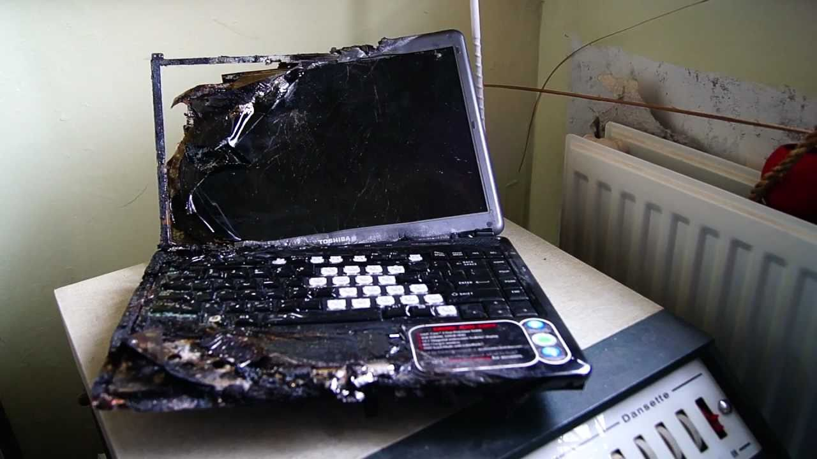
How it goes horribly wrong
Real-life acquisition fail…
Learn the tools you will be using
Practice using your tools ahead of time
Watch your surroundings

Slide 8
What should we get?
Memory dump – Try to acquire this first so you don’t trample over them memory with the rest of your searches
Disk dump – Also try to acquire this first so you don’t create more artifacts
System Config – Network settings, Shares, Drive info, Local user accounts, installed applications and patches
Network Connections – Who is the machine currently talking to
Startup Information – Programs or scripts set to run when machine is started up. Usually buried in registry keys
Running Processes and Services
Scheduled tasks
Cookies and Browser cache
List of USB devices used
Event Logs – Events cleared, time changes, logon failures, Privileged Use, application crashes, etc.

Slide 9
What should we get - Advanced
Drivers loaded
Last 50 DLLs created
Downloaded executable files
DNS cache (failed and successful)
Shellbags – Set of registry values for GUI useful for building timelines of events to prove suspect was traversing/viewing folders
Registry keys for shell commands, Browser helper objects, etc.
Interesting files (Prefetch, compressed, encrypted, ADS, no extension, etc.)
Live packet capture

Slide 10
Targeted searches
Once we pull all the static and dynamic information form the machine that we need, we may want to do more focused digging around
Files created/modified in the last X days or particular date
Files owned/modified by a particular user in last X days or particular date
IOC – Indicators of Compromise
These may be easier to search in memory dump, but some items can be found in disk also

Slide 11
IOCs
Been around for awhile, but gaining more traction. From our friend Wikipedia: Indicators of compromise (IOC) are artifacts observed on a network or in operating system that with high confidence indicates a computer intrusion.
Typical IOCs are virus signatures and IP addresses, MD5 hashes of malware files or URLs or domain names of botnet command and control servers. After IOCs have been identified in a process of incident response and computer forensics, they can be used for early detection of future attack attempts using intrusion detection systems and antivirus software.
Some examples include OpenIOC, Yara, Cybox or STIX files. Check out https://www.iocbucket.com for a great repository.

Slide 12
IOC Sample
Snipped for readability…

Slide 13

Attempt at Automation
In order to simplify all of the above, how about a Powershell (cheap!) script to rule them all! *with some caveats ☹
Cut to demo…

Slide 14
Attempt at Automation-Cont.
Why not Python?!?!?!?
Can’t install programs
Standalone python executable files tricky to modify on the fly
PS has good integration to all windows functions and installed by default
Many good disparate/outdated scripts exist currently to do this
No common framework to do acquisition and analysis
Like to accomplish something similar to SET, Metasploit etc. but for forensics.
Todo: Analysis script along the same lines by scripting most tasks
Automating the 80% most common tasks, will never replace actual work ☹
Gets values or paths of gathered files, keys etc. to speed up analysis
Option to copy files off as well
Uses Start-Transcript cmdlet to audit commands and output
Linux version in progress also…

Slide 15
Caveats
WinAPI calls used by powershell could be inaccurate due to rootkits
If Rootkit may be possible, check with GMER, RootkitRemover, Sophos, Malwarebytes, etc. first.
Pull from raw memory or raw disk versus WinAPI
Make sure you output to a remote fileshare or USB to avoid overwriting local disk and trashing unallocated/swap space
Needs a couple of helper programs (dumpit, dcfldd, etc.) – These could be run from powershell to capture raw data, but might be better from a legal standpoint to use known, trusted binaries.
Linux version should use trusted binaries in case of suspected rootkit also

Slide 16
What Next?
After the information is gathered and brought back to your forensic workstation, the actual work and analysis can begin.
Search through memory using Volatility for files, processes, passwords, registry keys etc. Check out the Volatility Plugins page!
Search through registry hives for shellbags with sbag (TZWorks)
Check active network connections against known blacklist IPs (OSINT lists)
Check sqlite databases (itunes backup) for phone activity
Run strings against the ADS files, selected binaries or files with no extensions, etc.

Slide 17

Thank You
For more information:
Web: reliaquest.com | Twitter: @reliaquest

